Slide 1
Generative Adversarial Network
Dr. Gahangir Hossain
Texas A&M University-Kingsville
Slides from: Ming Li

Slide 2
Generative Adversarial Network
GAN was first introduced by Ian Goodfellow et al in 2014
Have been used in generating images, videos, poems, some simple conversation.
Note, image processing is easy (all animals can do it), NLP is hard (only human can do it).
This co-evolution approach might have far-reaching implications. Bengio: this may hold the key to making computers a lot more intelligent.
Ian Goodfellow:
https://www.youtube.com/watch?v=YpdP_0-IEOw
Radford, (generate voices also here)
https://www.youtube.com/watch?v=KeJINHjyzOU
Tips for training GAN: https://github.com/soumith/ganhacks

Slide 3

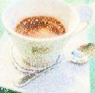
Autoencoder
As close as possible
NN
Encoder
NN
Decoder
code
Randomly generate a vector as code
NN
Decoder
code
Image ?

Slide 4
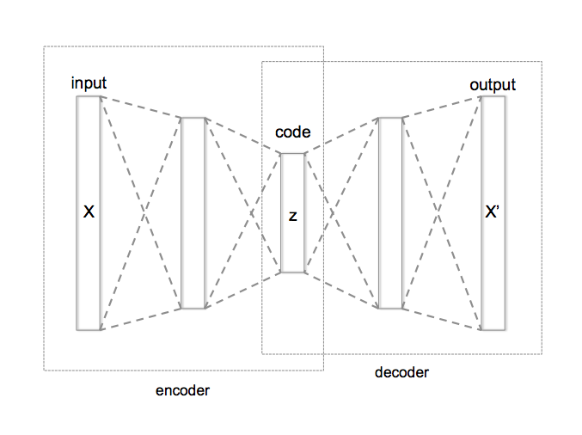
Autoencoder with 3 fully connected layers
Training: model.fit(X,X)
Cost function: Σ_{k=1..N} (x_{k} – x’_{k})²
Large → small, learn to compress

Slide 5
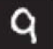

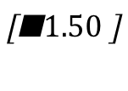
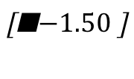
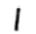
Auto-encoder
2D code
NN
Decoder
code
NN
Decoder
-1.5
1.5
NN
Decoder
Notes:
SOM: http://alaric-research.blogspot.tw/2011/02/self-organizing-map.html

Slide 6
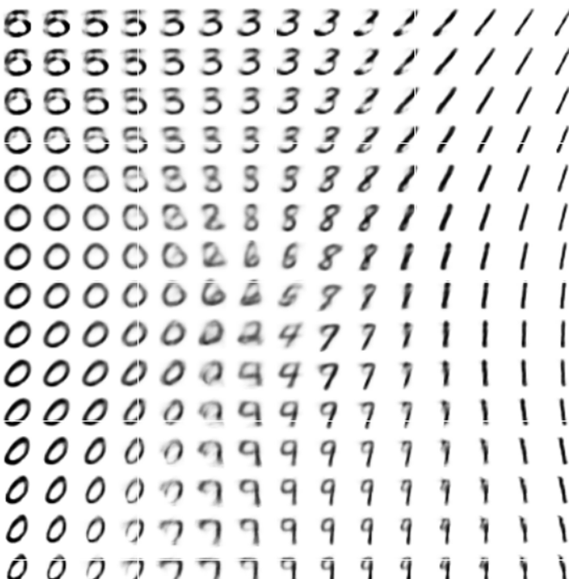
Auto-encoder
-1.5
1.5
Notes:
SOM: http://alaric-research.blogspot.tw/2011/02/self-organizing-map.html

Slide 7
Auto-encoder
NN
Encoder
NN
Decoder
input
output
code
VAE
Minimize reconstruction error
m₁
m₂
NN
Encoder
m₃
input
c₁
NN
Decoder
exp
+
c₂
output
σ₁
σ₂
c₃
σ₃
X
c_{i} = exp(σ_{i})e_{i} + m_{i}
From a normal distribution
e₁
e₂
Minimize
e₃
Σ_{i=1..3} [exp(σ_{i})−(1+σ_{i})+(m_{i})² ]
Auto-Encoding Variational Bayes, https://arxiv.org/abs/1312.6114
This constrains σ_{i} approacing 0 is good

Slide 8

Problems of VAE
It does not really try to simulate real images
code
NN
Decoder
Output
As close as possible
One pixel difference to the target
Also one pixel difference to the target
Realistic
Fake
VAE treats these the same

Slide 9


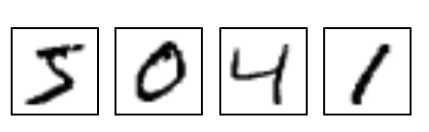
Gradual and step-wise generation
NN
Generator
v1
NN
Generator
v2
NN
Generator
v3
Discri-minator
v1
Discri-minator
v2
Discri-minator
v3
Generated
images
These are
Binary classifiers
Real images:

Slide 10
GAN – Learn a discriminator
NN
Generator
v1
Randomly sample a vector
0
0
0
0
Something like Decoder in VAE
Real images
Sampled from DB:
1
1
1
1
image
Discri-minator
v1
1/0
(real or fake)

Slide 11


GAN – Learn a generator
Randomly sample a vector
NN
Generator
v1
Updating the parameters of generator
Train
this
v2
The output be classified as “real” (as close to 1 as possible)
They have
Opposite
objectives
Generator + Discriminator = a network
Do not
Train
This
Discri-minator
v1
Using gradient descent to update the parameters in the generator, but fix the discriminator
1.0
0.13

Slide 12











Generating 2nd element figures
You can use the following to start a project (but this is in Chinese):
Source of images: https://zhuanlan.zhihu.com/p/24767059
From Dr. HY Lee’s notes.
DCGAN: https://github.com/carpedm20/DCGAN-tensorflow

Slide 13
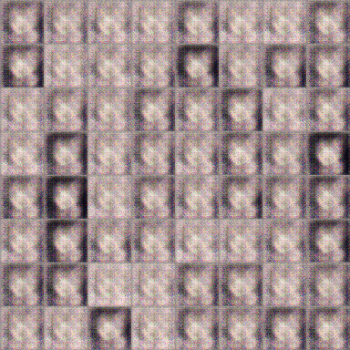
GAN – generating 2nd element figures
100 rounds
This is fast, I think you can use your CPU

Slide 14
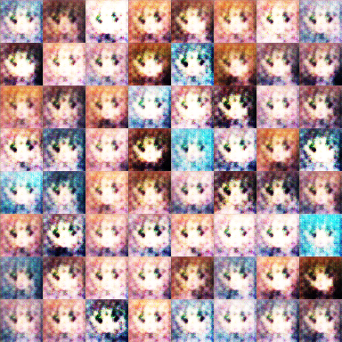
GAN – generating 2nd element figures
1000 rounds

Slide 15
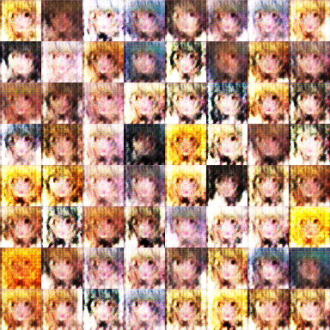
GAN – generating 2nd element figures
2000 rounds

Slide 16
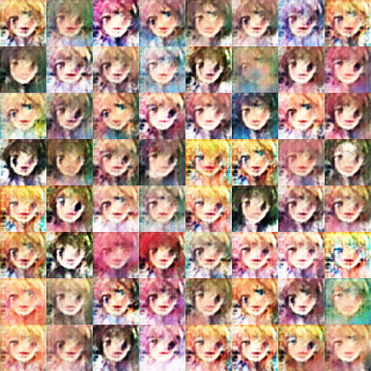
GAN – generating 2nd element figures
5000 rounds

Slide 17
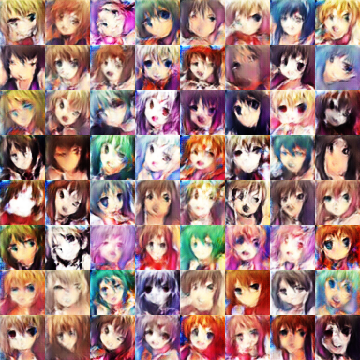
GAN – generating 2nd element figures
10,000 rounds

Slide 18
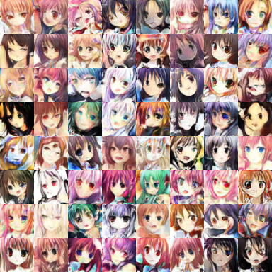
GAN – generating 2nd element figures
20,000 rounds

Slide 19
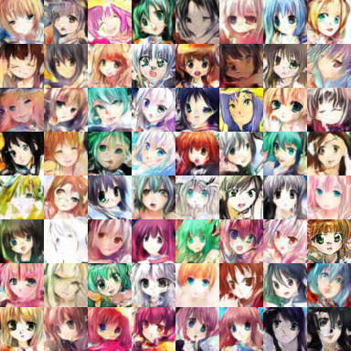
GAN – generating 2nd element figures
50,000 rounds

Slide 20
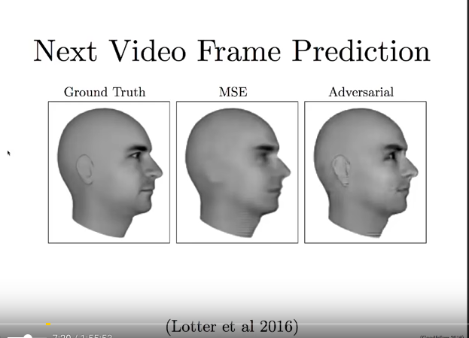
Next few images from Goodfellow lecture
Traditional mean-squared
Error, averaged, blurry

Slide 21
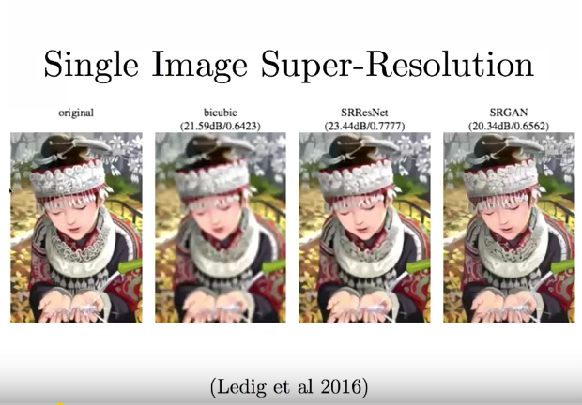
Last 2 are by deep learning approaches.

Slide 22
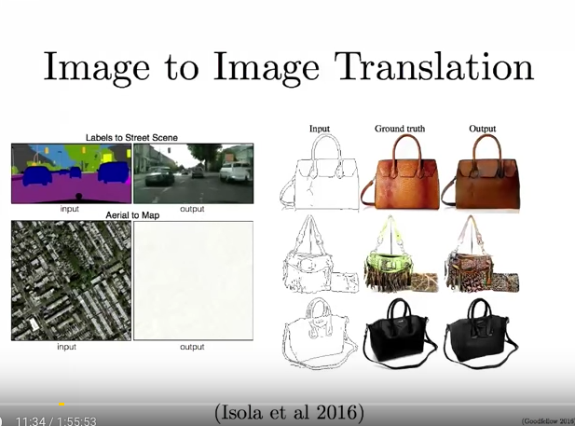

Slide 23
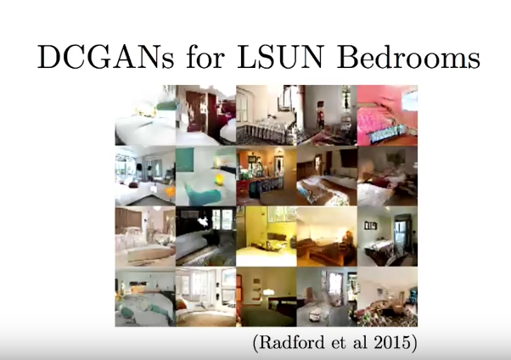

Slide 24
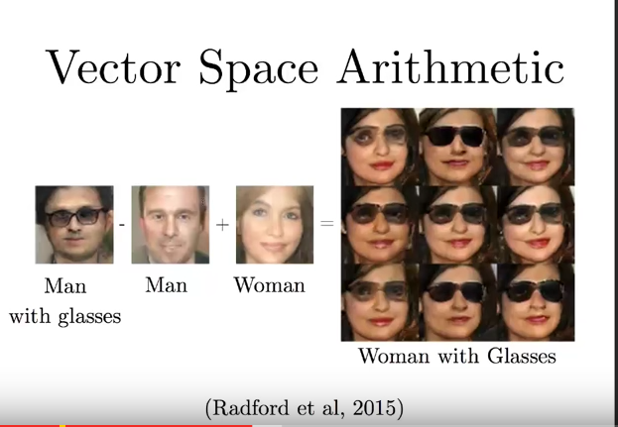
Similar to word embedding (DCGAN paper)

Slide 25
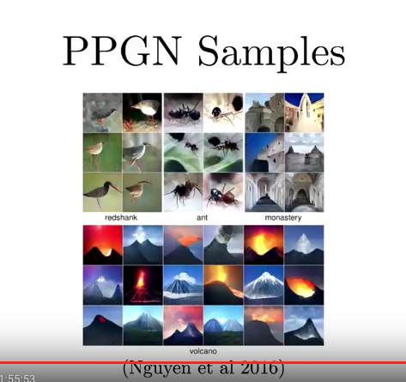
256x256 high resolution pictures by Plug and Play generative network

Slide 26
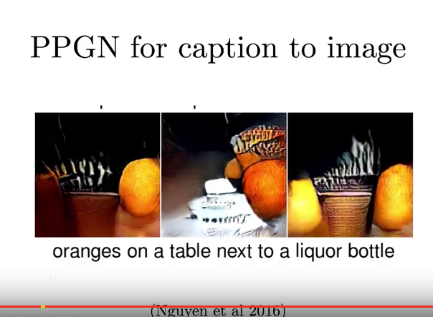
From natural language to pictures

